Slide 1
Viktor Segers
Central error and validation handling
using the Mediator Pattern

Slide 2


Viktor Segers
Full stack developer
Strong intrest/focus on:
Backend software architecture/structure
Cloud and DeVops
Notes:
Hello everyone, let me introduce mys

Slide 3
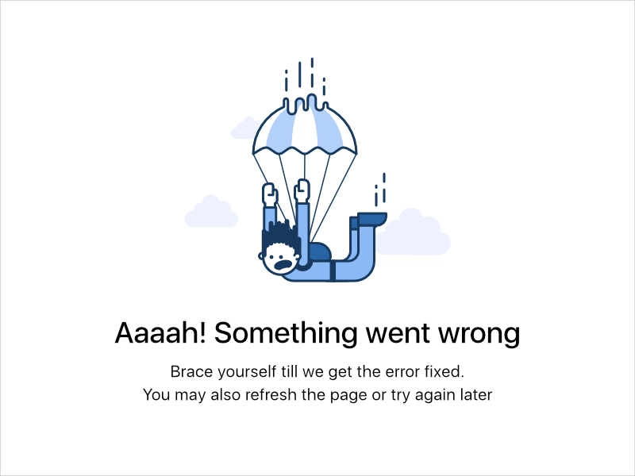
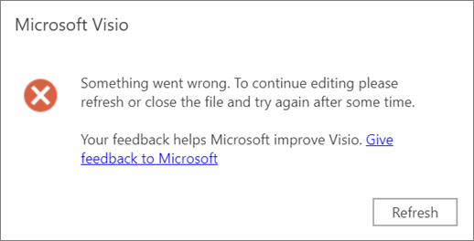
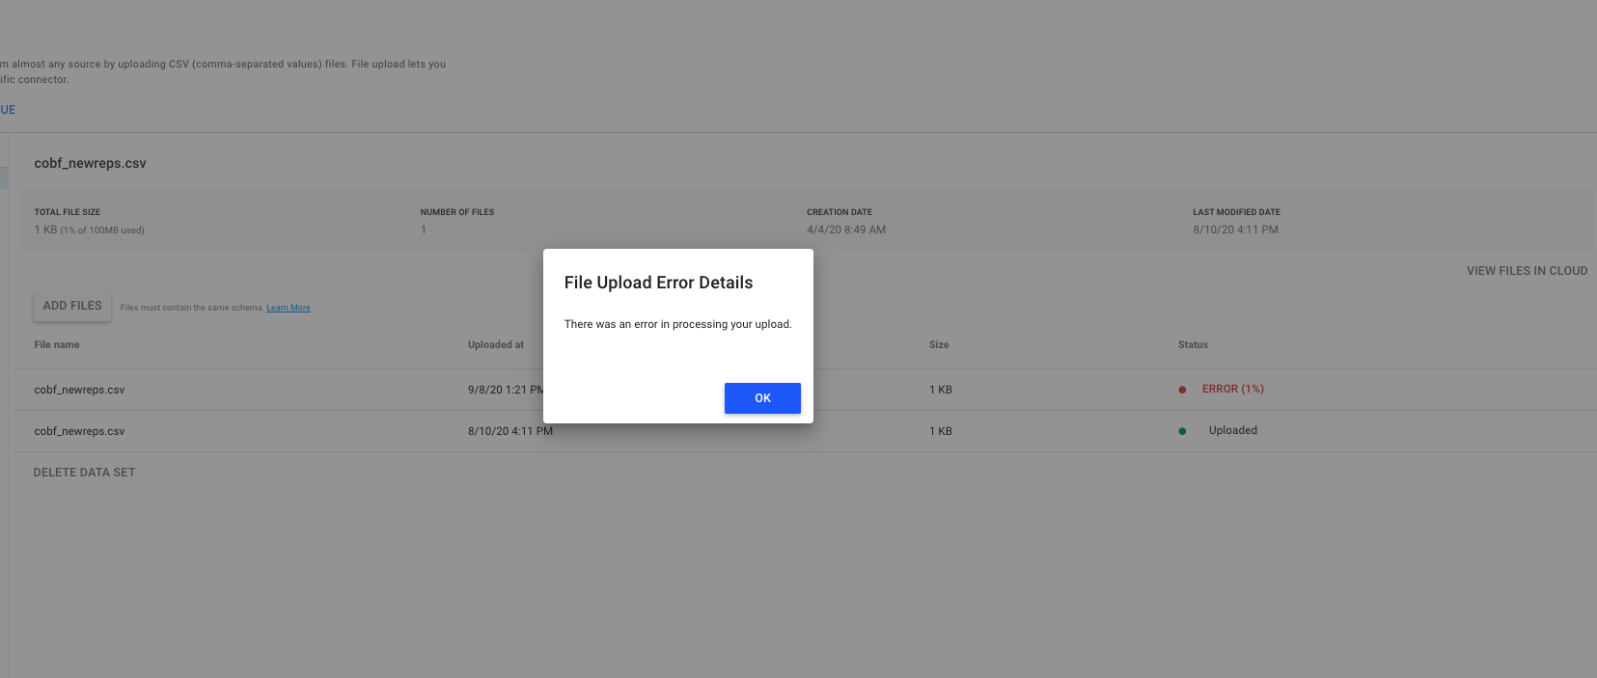
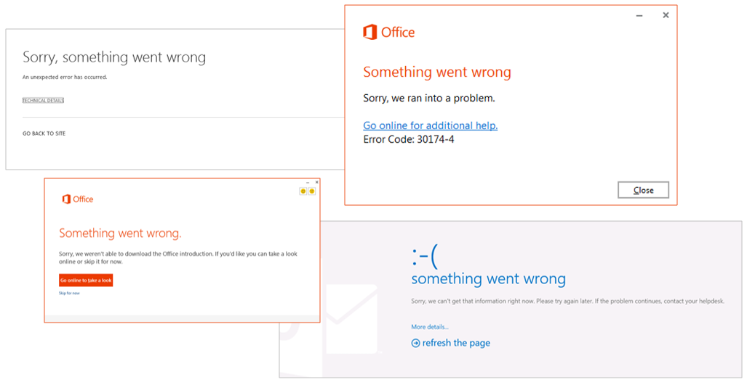
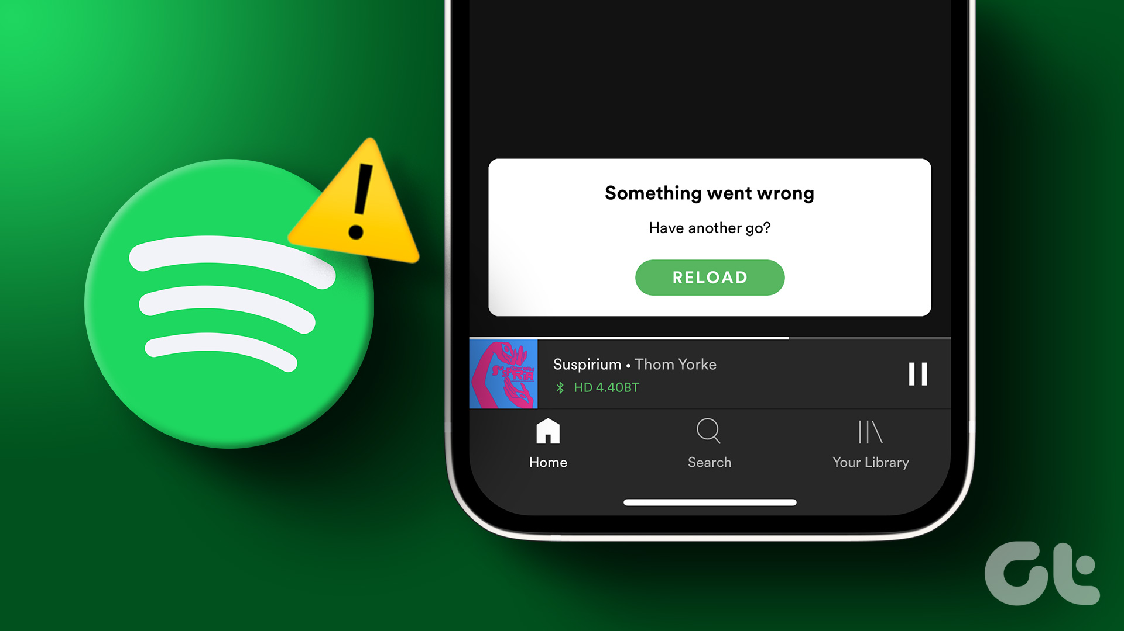
Something went wrong, please try again…

Slide 4


My cool API
REST
Admin portal
Notes:
Consuming a – in house build API – Easy to communicate about common situations with other developers

Slide 5




My cool API

Slide 6
Http response status codes
Informational 1xx
Successful 2xx
200 OK
201 created
Redirection 3xx
Client Error 4xx
Server Error 5xx
HTTP/1.1 502 BAD GATEWAY
Content-Type: application-json

Slide 7
Http response status codes 4xx & 5xx
400 Bad Request
401 Unauthorized
403 Forbidden
404 Not Found
500 Internal Server Error
502 Bad Gateway
504 Gateway Timeout

Slide 8
Http error code response with message
Add a message to the statuscode:
// Statuscode 403
// Content-Type: application/json
{
”message" : "Client's account doesn't have enough credit.",
”documentation": "http://MyEpicTicketshop.com/docs/didyoueveropendocumentation"
}
Understantable for humans, not for non-humans

Slide 9
Using a response wrapper
// Statuscode 200
// Content-Type: application/json
{
"data": null,
"messages":
[
"OrderNumber-'Order Number' must be 11 characters in length. You entered 6 characters.",
"OrderNumber-'Order Number' is not in the correct format.",
"OrderNumber-The specified condition was not met for 'Order Number’.”
],
"succeeded": false,
"validationFailure": ”Validation"
}
Notes:
Always 200

Slide 10
Using costum error codes
// Statuscode 400
// Content-Type: application/json
// https://developers.facebook.com/docs/graph-api/guides/error-handling/
{
"error":
{
"message": "Message describing the error",
"type": "OAuthException",
"code": 190,
"error_subcode": 460,
"error_user_title": "A title",
"error_user_msg": "A message",
"fbtrace_id": "EJplcsCHuLu"
}
}

Slide 11
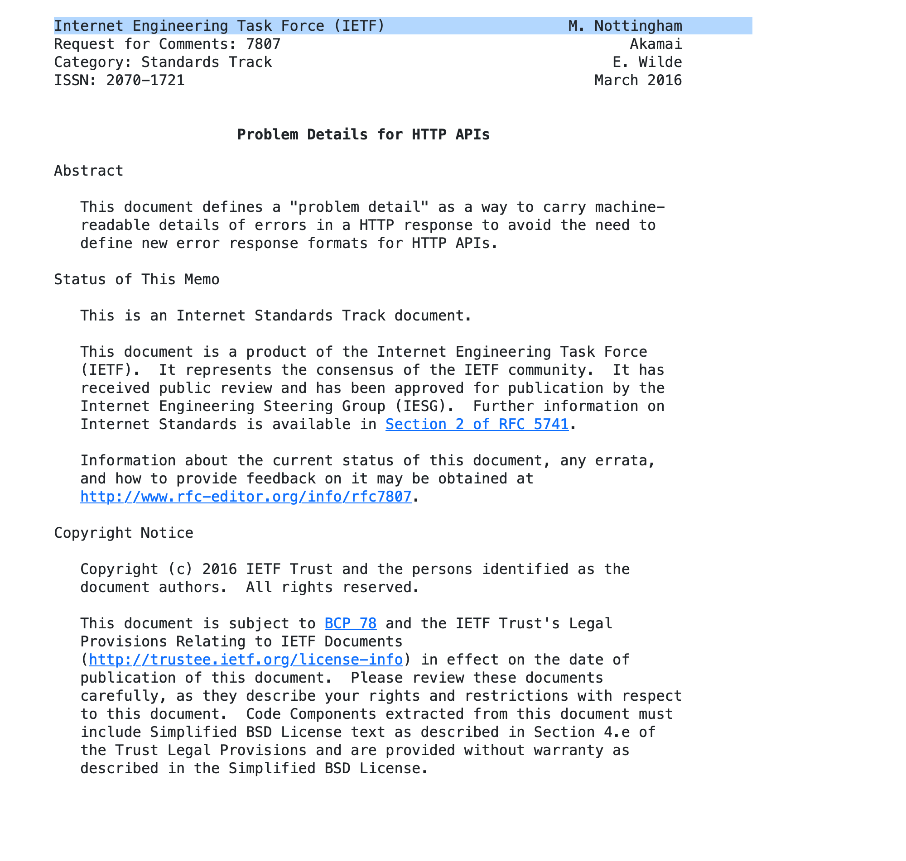
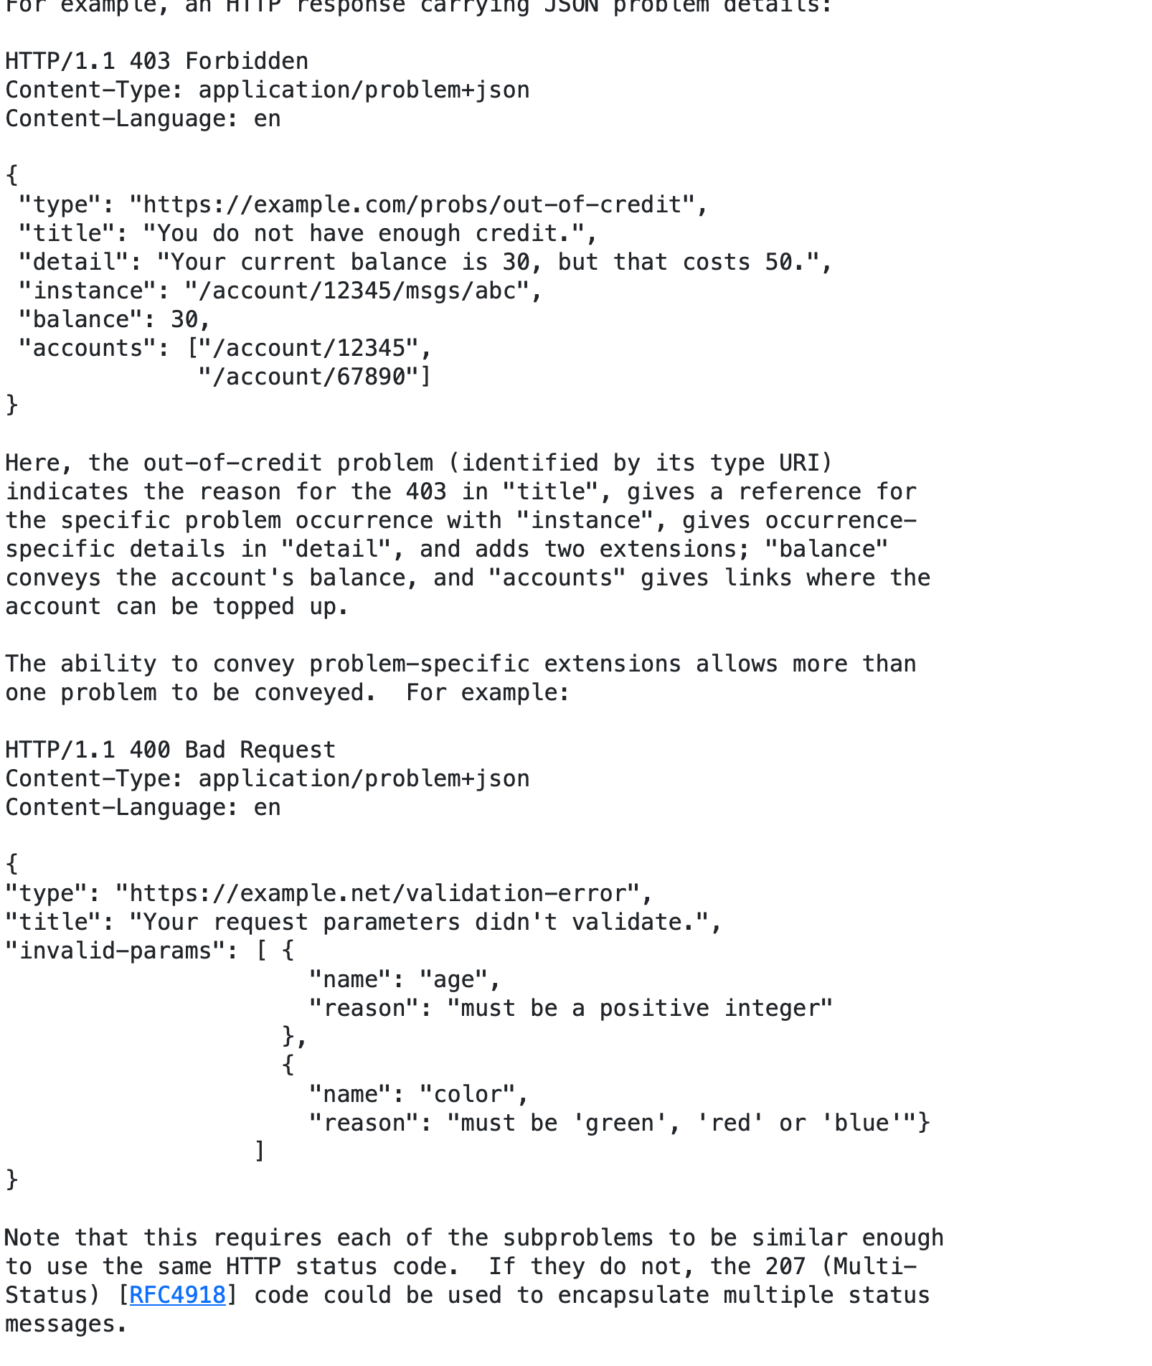
IETF RFC 7807: Problem Details
Notes:
Internet Engineering Task Force (IETF) - describes internet standards - 2016
JSON or XML Format data

Slide 12
Problem Details
Add a message to the statuscode:
// Statuscode 403
// Content-Type: application/problem+json
{
”type" : "http://MyEpicTicketshop.com/problems/out-of-credit",
”title": "You do not have enough credit.",
”status": "403”,
”detail": ”Your current balance is 30, but that costs 50.”,
”instance": ”/order/purchase/1123”,
”traceid": "6B29FC40-CA47-1067-B31D-00DD010662DA” // Extention
}
Notes:
Type: Stable, tells exactly with kind of error is represented
Trace: Extention

Slide 13
Problem Details
Add a message to the statuscode:
// Statuscode 422 (Unprocessable content)
// Content-Type: application/problem+json
{
”type" : "http://MyEpicTicketshop.com/problems/validation-error",
”title": "Your request parameters didn't validate.",
…
”Invalid-params":
{[{
”property": ”Age",
”Reason”: ”Must be greater or equal then 16",
”type" : "http://MyEpicTicketshop.com/problems/validation-error/integer-greater-then",
},
{
”property": ”Credit",
”Reason”: ”Must be greater then 0",
”type" : "http://MyEpicTicketshop.com/problems/validation-error/integer-greater-then",
}]
}

Slide 14
application/problem+json
My cool API
application/problem+json
application/problem+json
application/problem+json
application/problem+json
application/problem+json
application/problem+json

Slide 15

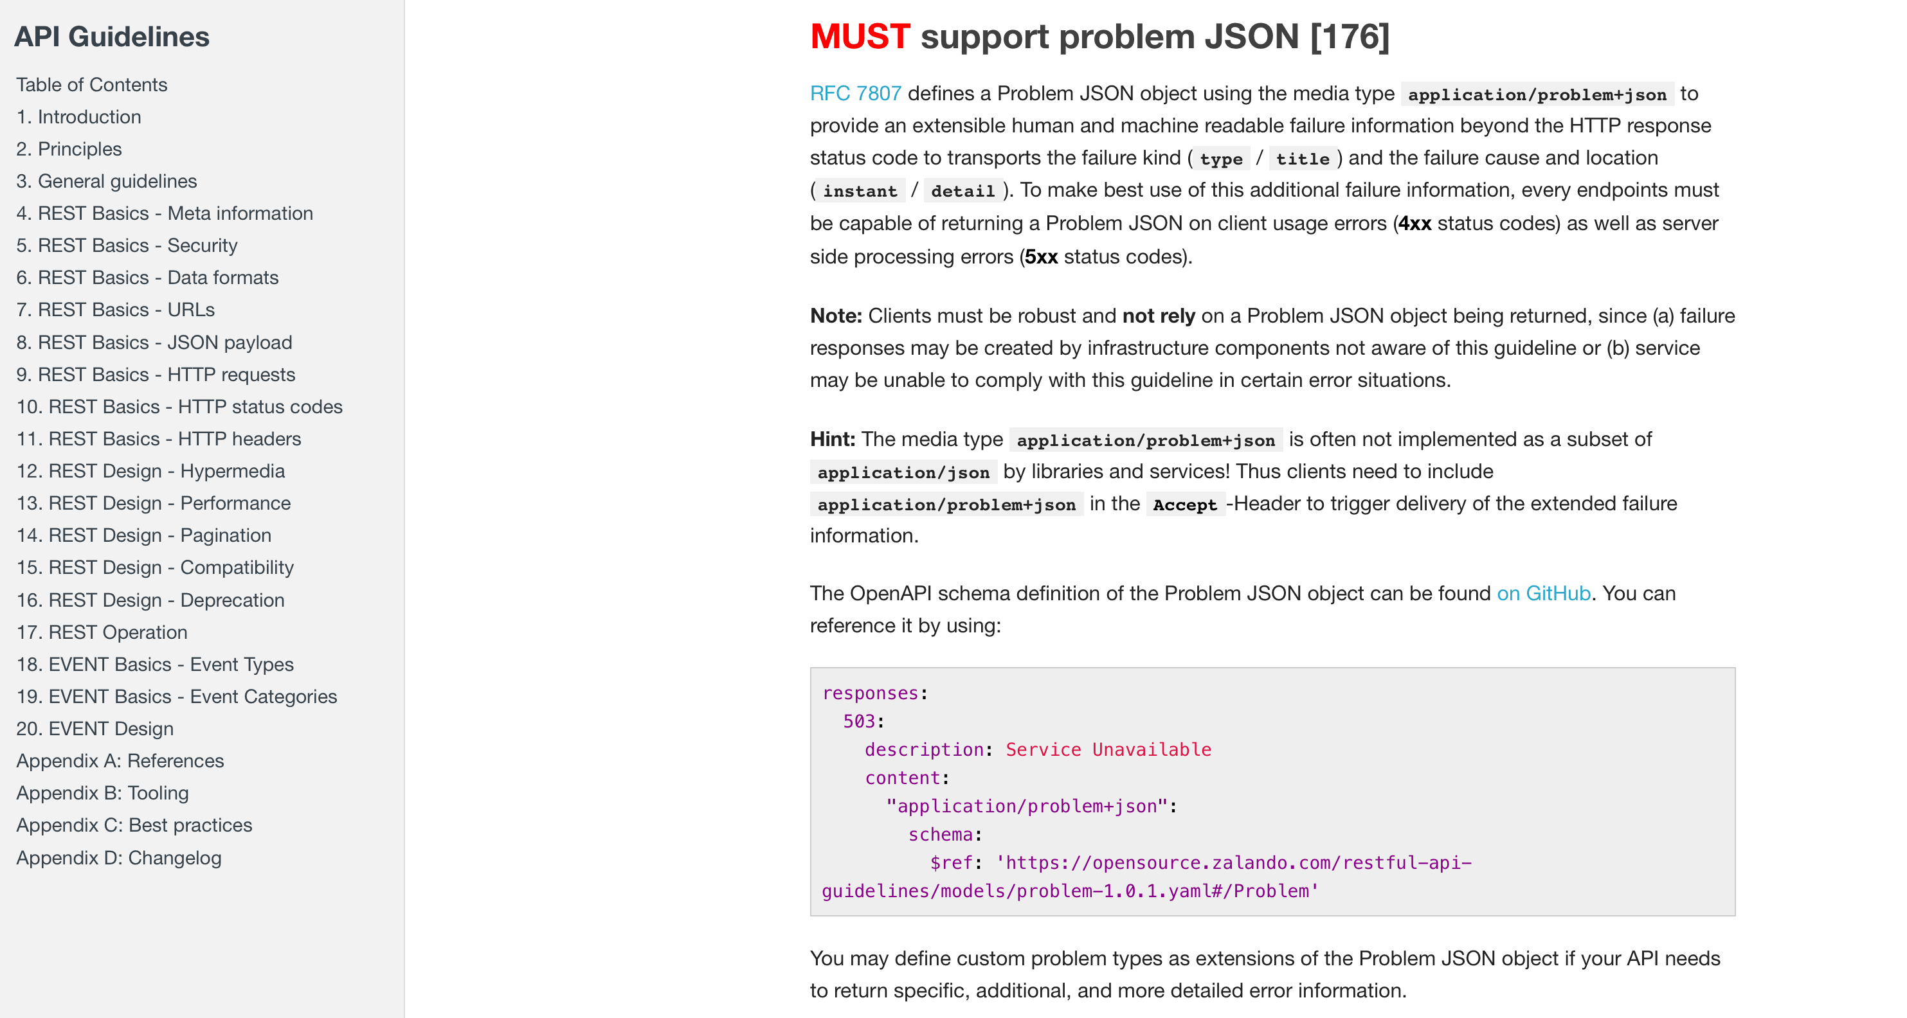
Problem details in practice
Microsoft, in their Azure API Management service - Google, in their Google Cloud Platform APIs
Notes:
Type: Stable, tells exactly with kind of error is represented
Trace: Extention

Slide 16
Problem details and .NET

Slide 17
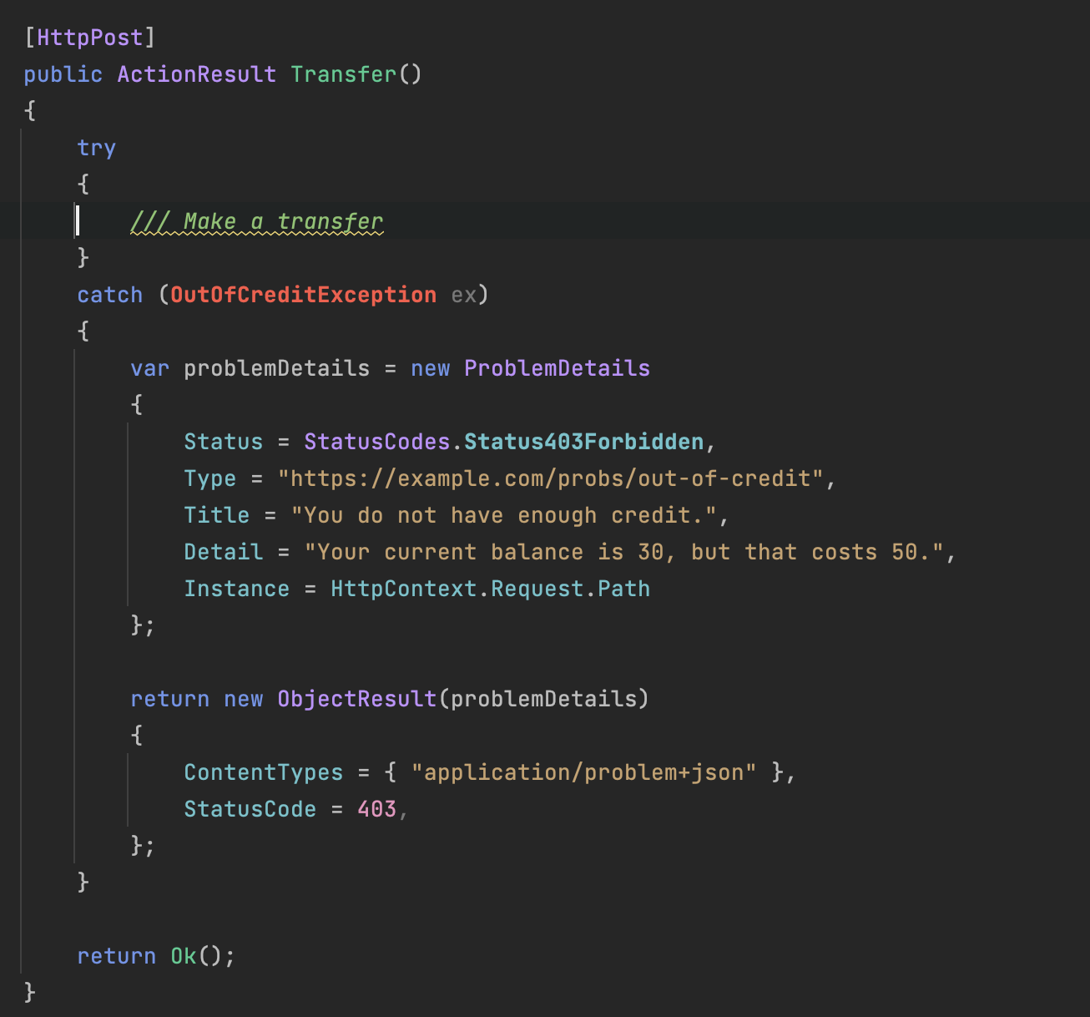
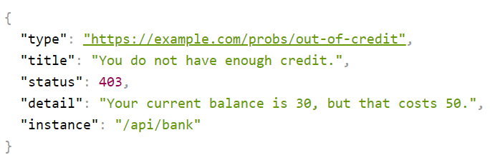
Problem details and .NET
ASP.NET CORE 2.1: first support for problem details
Notes:
Type: Stable, tells exactly with kind of error is represented
Trace: Extention

Slide 18
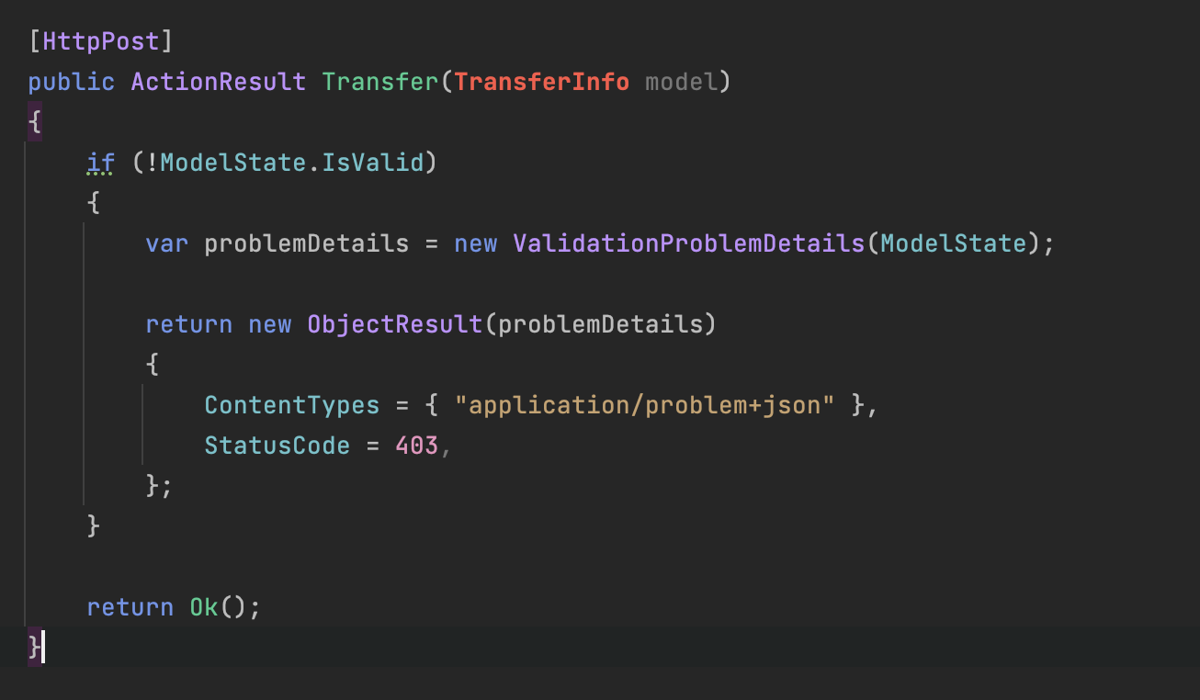
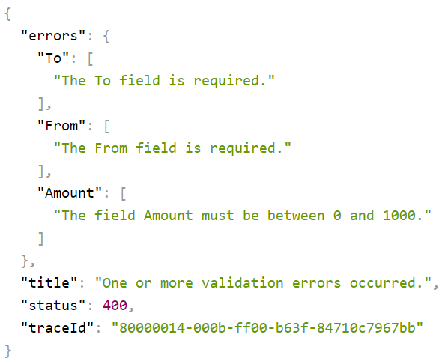
Problem details and .NET
ASP.NET CORE 2.1: first support for problem details
Notes:
Type: Stable, tells exactly with kind of error is represented
Trace: Extention

Slide 19
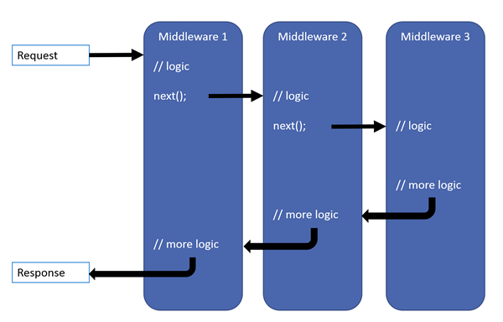
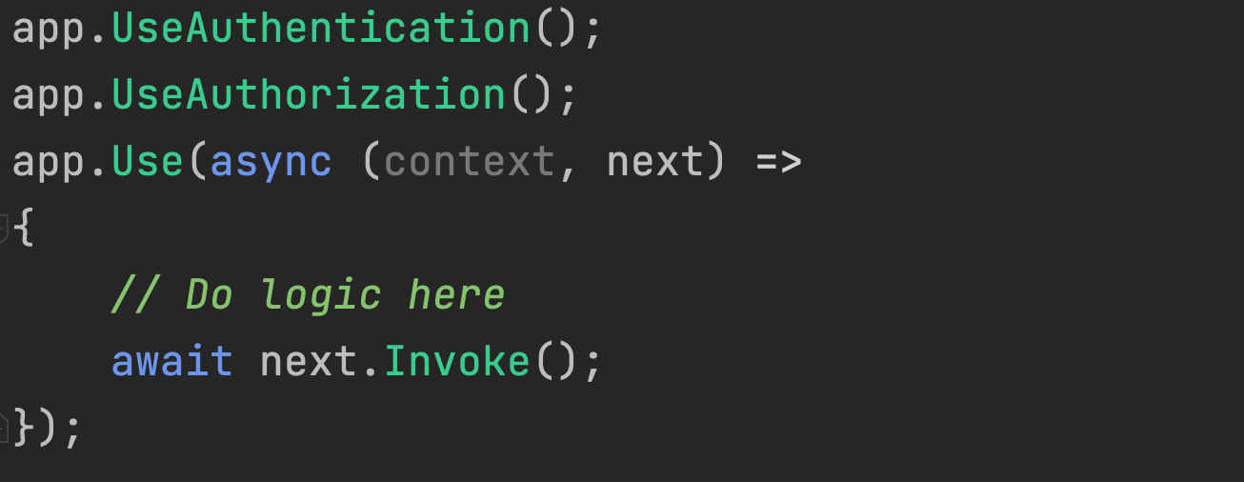
Middlewares
Notes:
.NET Core middleware is a pipeline of components in ASP.NET Core that processes HTTP requests and responses, allowing for customization and extension of web application functionality.
VALIDATIES
ERRORS TWEEDE

Slide 20
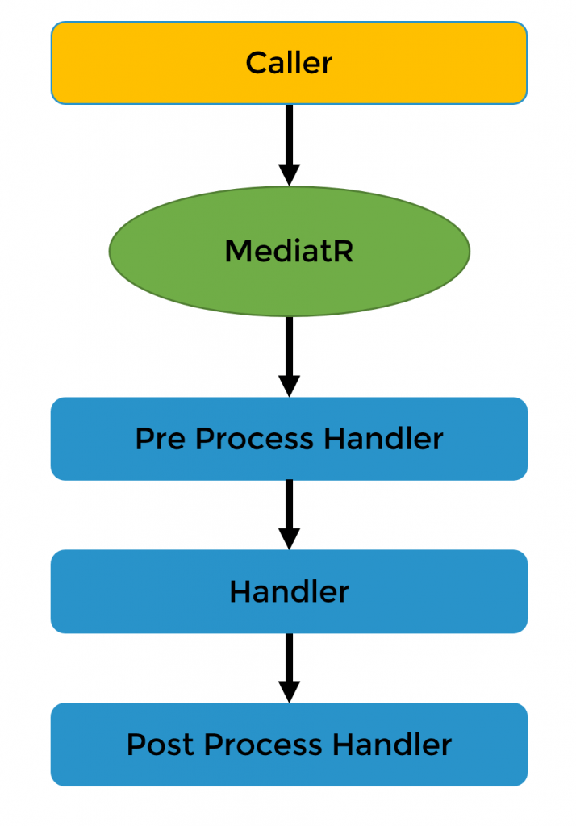
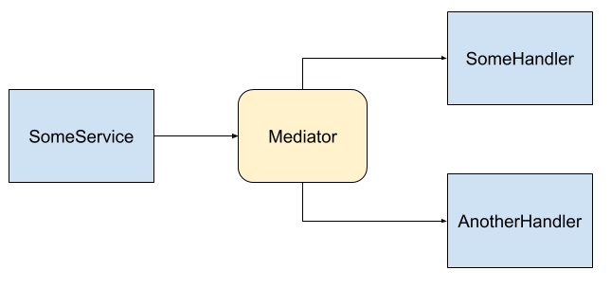
Mediator
Notes:
MediatR which is an implementation of the Mediator pattern that enables .net core developers to build simpler code by making all components communicate via a mediatorobject, instead of directly with each other. Helping code to remain highly decoupled and reducing complex dependencies between objects.
Laat .net core framework doen waar het goed in is: http
Meerdere endpoints mogelijk (service bus, …)

Slide 21




@involved_it
Veldkant 35C, 2550 Kontich
viktor.segers@involved-it.be

